Slide 1
Software Requirements Engineering
Lecturer: Ngo Huy Bien
Software Engineering Department
Faculty of Information Technology
VNUHCM - University of Science
Ho Chi Minh City, Vietnam
nhbien@fit.hcmus.edu.vn

Slide 2

Objectives

Slide 3

Contents

Slide 4

References
Karl Wiegers and Joy Beatty (2013). Software Requirements. Microsoft Press.
Bashar Nuseibeh and Steve Easterbrook (2000). Requirements Engineering - A Roadmap.
Karl Wiegers and Candase Hokanson (2023). Software Requirements Essentials. Addison-Wesley Professional.

Slide 5
Why Requirements Engineering? [1]
Inadequate user input, incomplete requirements, changing requirements, and misunderstood business objectives are major reasons why so many information technology projects are less than fully successful.
We sometimes fail to appreciate that requirements elicitation—and much of software and systems project work in general—is primarily a human interaction challenge.
No magical new techniques have come along to automate that, although various tools are available to help geographically separated people collaborate effectively.

Slide 6
Requirements Engineering [2]
Requirements engineering is the branch of software engineering concerned with the real-world goals for, functions of, and constraints on software systems.
It is also concerned with the relationship of these factors to precise specifications of software behavior, and to their evolution over time and across software families.
In reality, software cannot function in isolation from the system in which it is embedded, and hence RE has to encompass a systems level view.
The special consideration that software systems requirements engineering has received is largely due to the abstract and invisible nature of software, and the vast range and variety of problems that admit to software solutions.

Slide 7
Formal Description
Since software is a formal description, analysis of its behavior is amenable to formal reasoning. Logic provides a vehicle for performing such analysis
In RE, logic can be used to improve the rigor of the analysis performed, and to make the reasoning steps explicit.
Formal description techniques have received considerable attention in RE research, but have not yet been widely adopted into RE practice.
Since RE must span the gap between the informal world of stakeholder needs, and the formal world of software behavior, the key question over the use of formal methods is not whether to formalize, but when to formalize.

Slide 8
Cognitive and Social Sciences
RE needs to be sensitive to how people perceive and understand the world around them, how they interact, and how the sociology of the workplace affects their actions.
RE draws on the cognitive and social sciences to provide both theoretical grounding and practical techniques for eliciting and modeling requirements:
Cognitive psychology provides an understanding of the difficulties people may have in describing their needs.
Anthropology provides a methodological approach to observing human activities that helps to develop a richer understanding of how computer systems may help or hinder those activities.
Sociology provides an understanding of the political and cultural changes caused by computerization.
Linguistics is important because RE is largely about communication. Linguistic analyses have changed the way in which the English language is used in specifications.

Slide 9
Elicitation Techniques
Traditional techniques include the use of questionnaires and surveys, interviews, and analysis of existing documentation such as organizational charts, process models or standards, and user or other manuals of existing systems.
Group elicitation techniques include brainstorming and focus groups, as well as RAD/JAD workshops.
Prototyping has been used for elicitation where there is a great deal of uncertainty about the requirements, or where early feedback from stakeholders is needed.
Model-driven techniques include goal-based methods and scenario-based methods.

Slide 10
Requirements Validation
Validation is the process of establishing that the requirements and models elicited provide an accurate account of stakeholder requirements.
Techniques such as inspection and formal analysis tend to concentrate on the coherence of the requirements descriptions: are they consistent, and are they structurally complete?
Techniques such as prototyping, specification animation, and the use of scenarios are geared towards testing a correspondence with the real world problem.

Slide 11
Requirements Validation Problem
We can compare the problem of validating requirements with the problem of validating scientific knowledge. Many requirements engineers adopt a logical positivist approach – essentially the belief that there is an objective world that can be modeled by building a consistent body of knowledge grounded in empirical observation.
In RE, this view says that the requirements describe some objective problem that exists in the world, and that validation is the task of making sufficient empirical observations to check that this problem has been captured correctly.
Popper’s observations on the limitations of empirical observation apply here : that scientific theories can never be proved correct through observation, they can only be refuted.
For RE, this view suggests that validation should adopt the same stance that software testers take: it should devise experiments to attempt to refute the current statement of requirements.
Descriptions used in RE should be refutable – those that are not refutable are vague, and should only be treated as rough sketches.

Slide 12
Requirements Validation Problem
For requirements engineers, the methods and tools they use dominate the way that they see and describe problems.
In the extreme case, this shifts the problem of validating requirements statements to a problem of convincing stakeholders that the chosen representation for requirements models is appropriate.

Slide 13


Slide 14
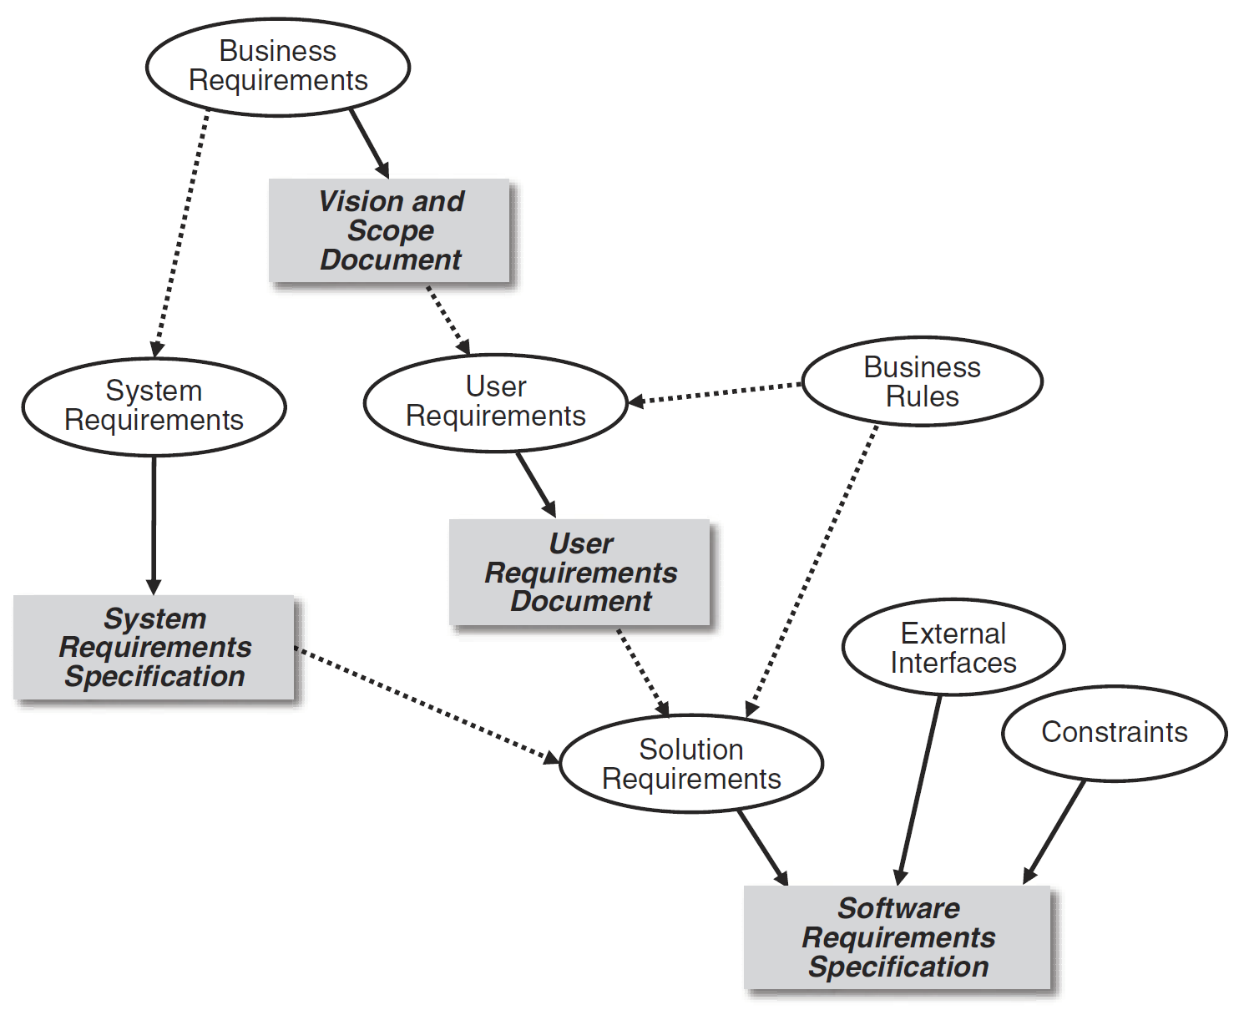
The Big Picture [3]

Slide 15
Requirements Elicitation
What do you want?
What are your requirements?
What do you want the system to do?
What features would you like to see in the system?
What do you need to do with the solution?

Slide 16
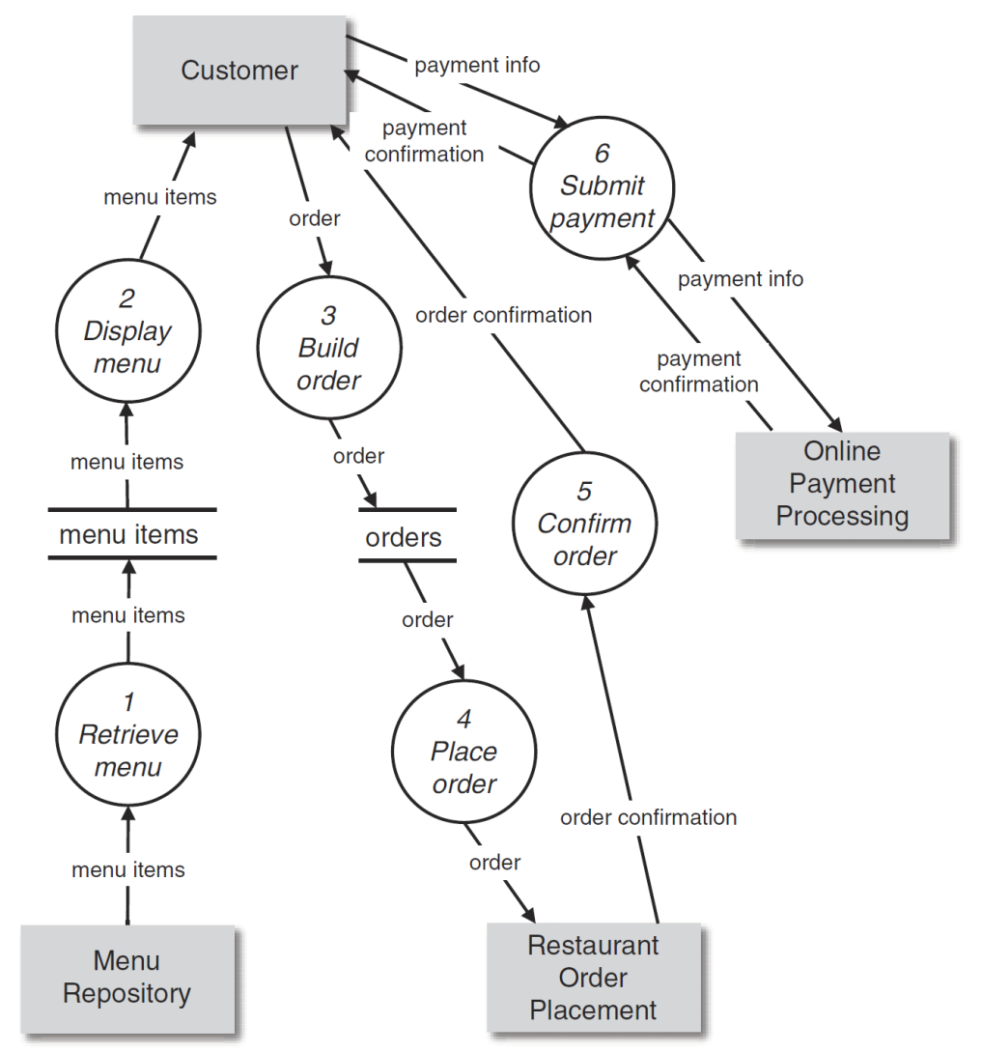
Data Understanding: DFD
A portion of a data flow diagram for the restaurant online ordering system
shows how menu, order, and payment information is used in various processes.

Slide 17
Summary
Requirements development demands an incremental and iterative approach.
The goal of all specification activities is clear and effective communication.
Requirements engineering is a collaborative activity.
Quality activities should be pushed to the front.
Risk thinking is essential.
Change happens.

Slide 18

Thank You & See You Again

